Slide 1
PARKING MANAGEMENT SYSTEM
GLA UNIVERSITY , MATHURA
DEPT. OF COMPUTER SCIENCE & ENGINEERING
Deepti Singhal - 2115000330
Kushagra Sharma - 2115000576
Naman Agarwal - 2115000644
Vedansh Gautam - 2115001104

Slide 2
Introduction
Welcome to our Parking Management System project, where smart solutions meet urban challenges head-on.
Motivated by urbanization's impact on parking inefficiencies, we aim to revolutionize the way parking spaces are managed.
Traditional systems struggle with congestion and delays. Our motivation is to streamline this process, making urban parking efficient and user-friendly.

Slide 3
Objectives
Streamlined Parking Processes
Real-time Monitoring
Improved and Fast Entry Management
Data Security
Scalability

Slide 4
Problem Statement
Traditional urban parking systems suffer from congestion and delays, creating frustration for users and inefficiencies in overall city management.
Efficient parking is crucial for reducing traffic, optimizing urban mobility, and enhancing the quality of life in rapidly growing urban spaces.
In the face of urbanization, our project addresses these challenges, offering a solution that goes beyond convenience – it's a necessity for the future of urban living.

Slide 5
Literature Review
Existing solutions often lack user-friendly interfaces and struggle with scalability in the face of increasing urbanization.
The current gap lies in the absence of a comprehensive, real-time Parking Management System that seamlessly integrates user convenience, efficient space utilization, and scalability to meet the dynamic demands of urban environments.
Our project introduces a sophisticated Parking Management System with real-time monitoring, user-friendly interfaces, and scalability, addressing the limitations of existing solutions and setting a new standard for urban parking efficiency

Slide 6
Methodology
HTML, CSS, Js for the user interface.
JavaScript for server-side scripting.
Employed Git for version control.
MongoDB for database handling.
Currently working on local server.

Slide 7
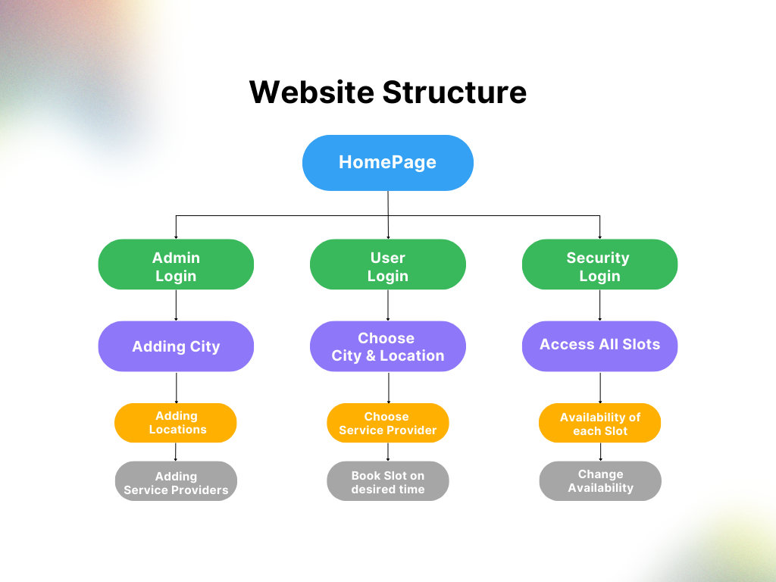
System Architecture

Slide 8
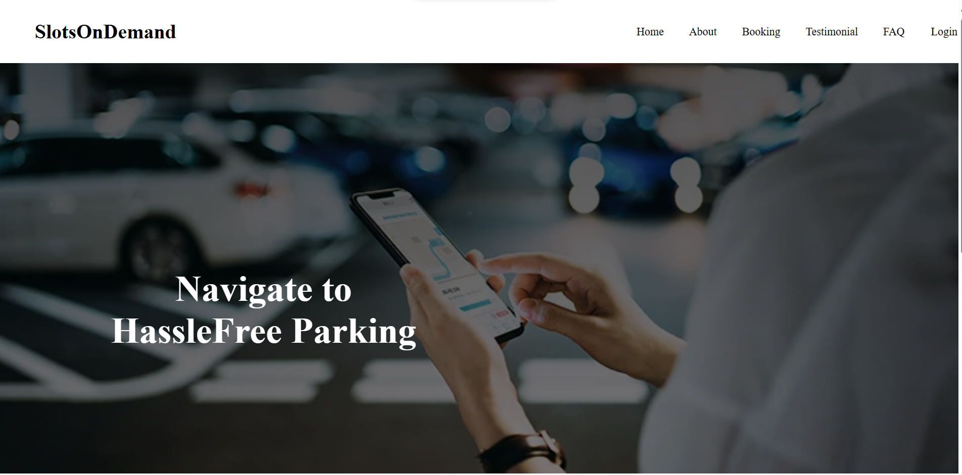
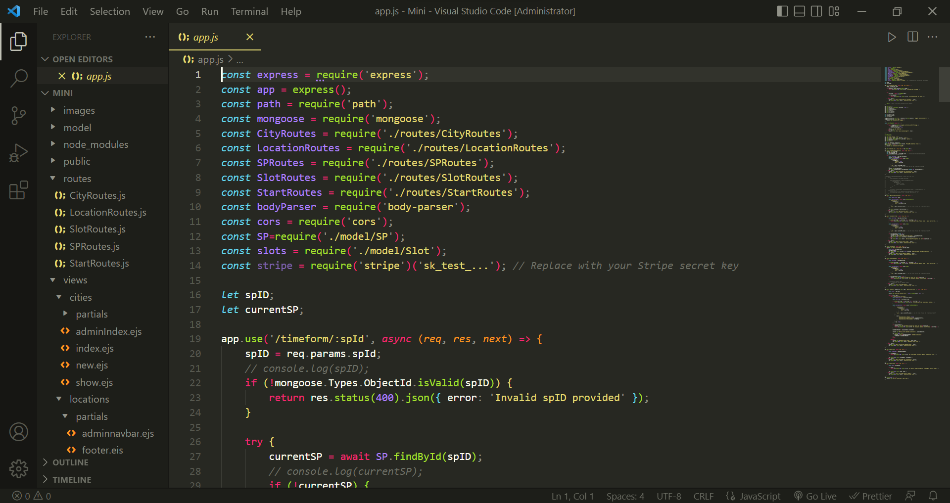
Implementation

Slide 9
Features
Real-time Monitoring
User-friendly Interface
Dynamic Slot Allocation
Improved and Fast Entry Management
Data Security Measures

Slide 10
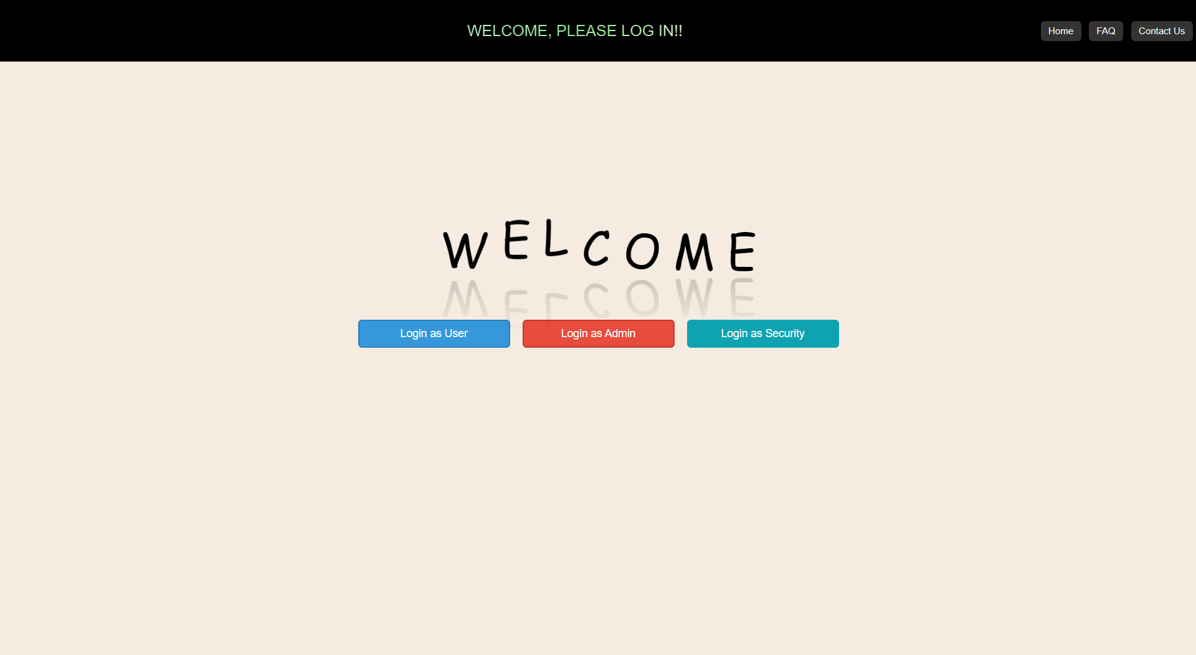
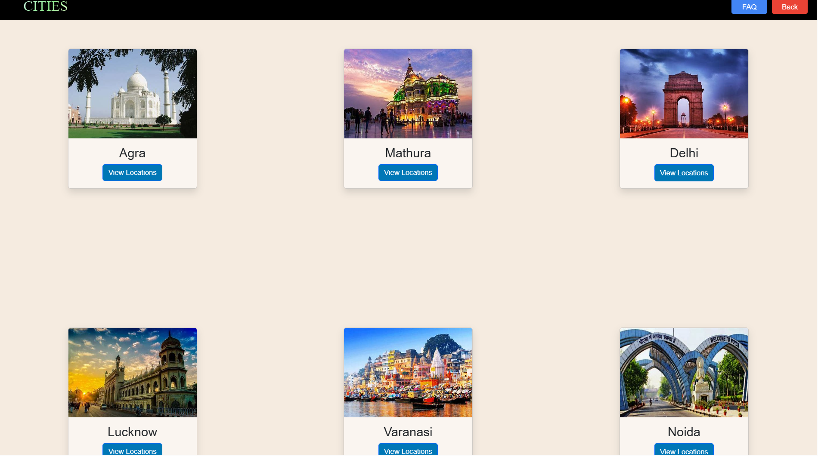
Results
Login Page
User Interface

Slide 11
Challenges Faced
Safeguarding user data from potential security threats.
Ensuring thorough testing of the system's functionalities.
Coordinating and managing contributions from multiple team members.

Slide 12
Future Work
Mobile App Integration
Predictive Analytics
Automated Valet Services

Slide 13
Conclusion
Urban parking inefficiencies: congestion, delays, and user frustration.
Importance: Efficient parking crucial for traffic reduction and enhanced urban living.
Project significance: Real-time monitoring, user-friendly interfaces, scalability.
Goal: Revolutionize urban parking standards for future mobility and quality of life.

Slide 14
Acknowledgment
We express sincere gratitude to our mentor for his invaluable guidance, shaping our project's direction.
Special thanks to our peers for their collaborative efforts, constructive feedback, and shared enthusiasm.
Additionally, we acknowledge the support of friends who contributed to our journey.

Slide 15
ThankYou

